Slide 1
AI-Driven Bayesian Templates for Hubbard’s AIE in engineering decisions under uncertainty
Tutorial
Kirtis Christensen
Open. RTX Proprietary
RTX Corporation (Corporate) - Company Use This document does not contain any export controlled technical material/data/information.

Slide 2
Tutorial for – AI, Measures, Decisions in uncertainty
Applied information Economics approach to measuring problems
Using AI to map problem types to solution workflows
Reusable template (Jupyter notebook) for mapping each problem
AI assistance in mapping problem decomposition to workflow
RTX Corporation (Corporate) - Company Use This document does not contain any export controlled technical material/data/information.

Slide 3
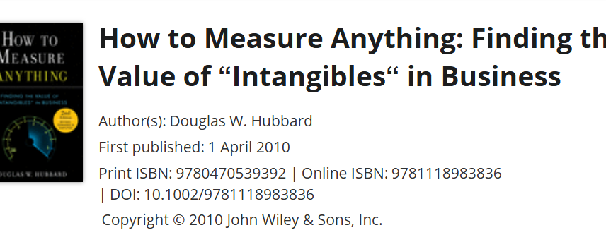
What is AIE? Who is Hubbard?
The tutorial follows the 5-step AIE process, enhanced with Bayesian methods and automated by LLMs:
The 5-Step Process – Sections:
1 . 3. Define the decision and uncertainties - What exactly are we deciding, and what don't we know?
2 . 4. Determine what measurements matter - Which uncertainties are actually worth resolving?
3 . 5. Measure highest-value items - Collect evidence on the most valuable uncertainties
4 . 6,7,8. Use information to update beliefs - Incorporate new data into our understanding
5 . 9. Make the decision - Choose based on expected value
Proven method and mindset for finding measures to reduce uncertainty
RTX Corporation (Corporate) - Company Use This document does not contain any export controlled technical material/data/information.

Slide 4
Section 1: Environment Setup
Prerequisites
Setup Options
Google Colab (Recommended): Use the provided Colab badge to open in browser
Local Installation: Follow instructions in QUICKSTART.md
Python 3.8+ environment
Required packages: numpy, scipy, pandas, matplotlib, seaborn, networkx, openai, pymc, arviz, ipywidgets
OpenAI API key (or Ollama local endpoint)
Key Configuration
Configure LLM provider (OpenAI/Ollama)
Set API credentials
Verify connection before proceeding
Tutorial OpenAI Key provided for Tutorial – Please use your own key if you have one
RTX Corporation (Corporate) - Company Use This document does not contain any export controlled technical material/data/information.

Slide 5
Section 2: Background
Doug Hubbard's Applied Information Economics (AIE)
Core Principle: Measure only what matters most to reduce uncertainty in your decision.
The 5-Step Process:
Define the decision and uncertainties - What exactly are we deciding, and what don't we know?
Determine what measurements matter - Which uncertainties are actually worth resolving?
Measure highest-value items - Collect evidence on the most valuable uncertainties
Use information to update beliefs - Incorporate new data into our understanding
Make the decision - Choose based on expected value
AIE methodology is extensively covered in Hubbard's seminal work:
Hubbard, D. W. (2014). How to Measure Anything: Finding the Value of "Intangibles" in Business (3rd ed.). Wiley.
Hubbard, D. W. (2018). The Failure of Risk Management: Why It's Broken and How to Fix It. Wiley.
- AIE + Bayesian Concepts - Enhancements
RTX Corporation (Corporate) - Company Use This document does not contain any export controlled technical material/data/information.

Slide 6
Section 3: Step 1 - Define the Decision & Uncertainties
Process
Select or customize a scenario from the library:
Pump maintenance (preventive vs reactive)
Conveyor gearbox (predictive vs scheduled)
Safety valve (inspection intervals)
Key parameters to define:
Problem description (natural language)
Decision options (exactly 2)
Objective (what we're optimizing)
Time horizon
Cost structure
Observed data
Industry benchmarks
Why This Matters
A precise framing produces a precise model. Vague problem descriptions lead to vague solutions. The LLM parser in Section 4 will convert this structured input into a Bayesian model.
This step aligns with Hubbard's emphasis on precise problem definition in How to Measure Anything (Chapter 2: "The Problem-Solving Process").
RTX Corporation (Corporate) - Company Use This document does not contain any export controlled technical material/data/information.

Slide 7
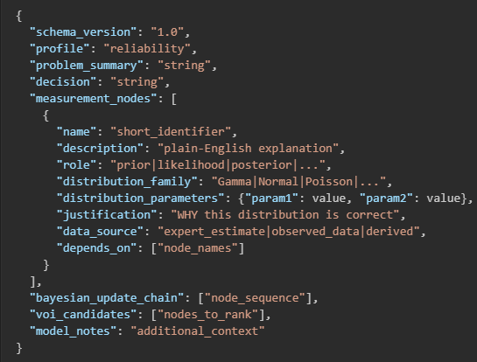
Section 4: Step 2 - LLM Problem Parser → JSON
Objective - Convert the natural language problem description into a structured Bayesian model.
Process
Send problem description to LLM with specific instructions:
Identify all uncertain quantities (measurement nodes)
Assign appropriate probability distributions
Specify node roles (prior, likelihood, posterior, etc.)
Justify distribution choices
LLM Output Structure
Validation & Repair:
Check against canonical schema
Automatically repair common LLM errors
Preserve valid LLM content
Fallback Option
If LLM is unavailable, use procedural template that builds Gamma-Poisson model from decision frame parameters.
This automated parsing approach exemplifies the "Measurement Process" described in Hubbard's How to Measure Anything (Chapter 3) and leverages modern AI capabilities to accelerate the measurement identification phase.
RTX Corporation (Corporate) - Company Use This document does not contain any export controlled technical material/data/information.

Slide 8
Section 5: Step 3 - Value of Information (VoI) Ranking
Objective - Calculate Expected Value of Perfect Information (EVPI) for key uncertainties to determine what's worth measuring.
Process
Calculate EVPI:
EVPI = E[Cost under uncertainty] - E[Cost with perfect information]
Interpretation:
EVPI > measurement cost: Worth investing in better data
EVPI < measurement cost: Current data is sufficient
Three-tier measurement cost model:
Low-effort (1% of failure cost): Peer/historical data
Mid-effort (5% of failure cost): Sensor/inspection data
High-effort (15% of failure cost): Continuous monitoring
Key Insights
Only invest in measurement if EVPI > measurement cost
Focus resources on highest-value uncertainties
Avoid expensive data collection that won't change decision
The EVPI calculation is fundamental to Hubbard's approach and is thoroughly explained in How to Measure Anything (Chapter 4: "The Value of Information"). This quantitative approach ensures that measurement efforts are directed toward the most impactful uncertainties.
RTX Corporation (Corporate) - Company Use This document does not contain any export controlled technical material/data/information.

Slide 9
Section 5: Step 3 – Iterative (VoI) Analysis
Suggested Steps
Section 3 – Step 1:
Set observed failures to 1
Set PM Eff LB to .05 and UB to .55
Apply the scenarios button and check for update on screen
2. Section 4 – step 2:
Run the block code to send the data to the LLM problem parser for analysis
It will select best distribution &parameters for each measure, and return json for next workflow section.
Run Validate block and note naming fixes
3 Section5 – step 3:
Run VOI compute block
Note the change from PM to RTF and the VOI of -$97 to $706
Run VOI Plot block
Note the table for interpreting
Set PM Cost to $4400, rerun blocks
Note RTF is selected as the best option
Explore – What happens if I change the number of observed failures of if I change my SME calibrated impact for preventative maintenance?
Key Insights
LLM AI selects measures & distributions best for the problem type.
The value of information justifies SME estimates versus $ for deeper dive study of real data collection
The EVPI calculation ensures that measurement efforts are directed toward the most impactful uncertainties.
RTX Corporation (Corporate) - Company Use This document does not contain any export controlled technical material/data/information.

Slide 10
Section 6: Step 4 - Calibrated Priors (Two Paths)
Objective - Establish well-calibrated prior beliefs about uncertain quantities.
Path A: Expert Calibrated Prior
Process:
Elicit expert's 90% confidence interval on MTBF (Mean Time Between Failures)
Convert to failure rate (λ = 1/MTBF) 90% CI
Fit Gamma distribution to match the CI
Why Gamma?
Conjugate prior for Poisson failure processes
Natural for rate parameters
Flexible shape to match expert beliefs
Path B: Data-Fitted Prior
Process:
Input observed time-to-failure (TTF) data
Fit descriptive distributions (Exponential/Weibull)
Derive Gamma prior via conjugate update from flat prior
Comparison
Both paths produce Gamma priors on failure rate λ that compete in the three-way sensitivity analysis.
Key Insight:
Weibull shape parameter (k) reveals failure mechanism:
k < 1: Infant mortality (decreasing hazard)
k = 1: Random failures (constant hazard)
k > 1: Wear-out (increasing hazard
Hubbard emphasizes the importance of calibrated priors in How to Measure Anything (Chapter 5: "The Measurement Process"). The two-path approach here demonstrates both expert elicitation (Path A) and data-driven calibration (Path B) methods.
RTX Corporation (Corporate) - Company Use This document does not contain any export controlled technical material/data/information.

Slide 11
Section 6: Step 4 - Calibrated Priors (Plots Explained)
Let Panel Plot
Expert Prior (blue dashed) — This is what the SME believed about λ before looking at any failure data. It's fitted purely from the MTBF 90% CI entered in Section 3 (e.g., "I'm 90% confident MTBF is between 9 and 14 months"). It answers: what does our engineering knowledge alone say about how fast this pump fails?
Data Prior/conjugate (purple dotted) — This is what the observed TTF data alone implies about λ, with no expert input. It uses the conjugate update: if you saw n time-to-failure observations totaling T months of exposure, the posterior from a flat (uninformative) prior is Gamma(n, T). It answers: what does the raw failure timing data say, with zero prior assumptions?
Expert Posterior (green shaded) — This is the Bayesian update: the Expert Prior multiplied by the likelihood of the observed failure count (k failures in t months). It's computed analytically via Gamma-Poisson conjugacy as Gamma(α_expert + k, β_expert + t). It answers: what do we believe about λ after combining our engineering knowledge with the observed failure count?
Key Insight:
The spread between these three curves is the Section 7 "prior sensitivity" story — if they cluster tightly, the data dominates and it doesn't matter much what prior you started with. If they're spread apart, your starting belief significantly drives the conclusion.
- Our 3 failures in 24 months from section 3 was our starting knowledge. Now we have new actual TTF data in path by to use.
The two-path approach here demonstrates both expert elicitation (Path A) and data-driven calibration (Path B) methods.
RTX Corporation (Corporate) - Company Use This document does not contain any export controlled technical material/data/information.

Slide 12
Section 6: Step 4 - Calibrated Priors (Plots Explained)
Right Panel Plot
This plots the raw TTF histogram with two descriptive fits:
Weibull (red) — flexible, captures aging behavior
Exponential (black dashed) — the memoryless baseline
The key number is Weibull shape k:
k < 1 → hazard rate decreases with age (infant mortality — early defects burning in; PM doesn't help much)
k = 1 → constant hazard (random failures; PM provides no age-related benefit)
k > 1 → hazard rate increases with age (wear-out; this is where PM genuinely helps by resetting the clock)
Key Insight:
So the right panel tells you whether the physics of failure supports PM as a strategy — independent of cost calculations. If the data shows k > 1, that's evidence that an aging mechanism exists and PM interventions have mechanical justification.
The two-path approach here demonstrates both expert elicitation (Path A) and data-driven calibration (Path B) methods.
RTX Corporation (Corporate) - Company Use This document does not contain any export controlled technical material/data/information.

Slide 13
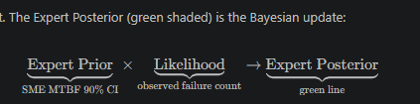
Section 6: Step 4 - Calibrated Priors (Exploration)
Exploration
Steps:
In section 6 Path B
Change the TTF actual data to match our original problem data of 3 failures in 24 months.
Use [6,8,10] for the new actual TTF data in the entry box.
Click the Apply the Observed TTFs button
Note the Gamma(alpha=3.00, rate=24.00) has changed to reflect the 3 failures over 24 months.
Rerun the Section6_Step4_Compute_Path_B() block
Rerun the Section6_Step4_Plot_Prior_Comparison() plot
Notice now our expert estimates of LB 9 and UB 14 match our original experience of 3 failures in 24 months more closely.
Key Insight:
Our 3 failures in 24 months from section 3 was our starting knowledge. Now we have new actual TTF data in path by to use.
- What if we plotted against that original knowledge?
The two-path approach here demonstrates both expert elicitation (Path A) and data-driven calibration (Path B) methods.
RTX Corporation (Corporate) - Company Use This document does not contain any export controlled technical material/data/information.

Slide 14
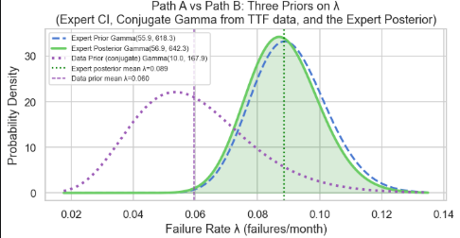
Section 6: Step 4 - Calibrated Priors (Exploration)
Exploration
Steps:
In section 6 Path B
Click Reset button.
Click the Apply the Observed TTFs button
Note the Gamma(alpha=10.00, rate=167.95).
mean lambda=0.0595 fail/mo → implied MTBF 16.8 mo
In Section 6 Path A
Set MTBF LB to 5 but raise UB to 17 months for our new data.
Click Apply Expert CI button.
Rerun Section6_Step4_Compute_Path_A() block
Rerun the Section6_Step4_Compute_Path_B() block
Rerun the Section6_Step4_Plot_Prior_Comparison() plot
Notice the estimates of LB 5 and UB 17 effect
Key Insight:
Lets use the new new actual TTF data.
That new knowledge changes our SME estimates?
revise our SME estimates from it some. [9,14] to ?
The two-path approach here demonstrates both expert elicitation (Path A) and data-driven calibration (Path B) methods.
RTX Corporation (Corporate) - Company Use This document does not contain any export controlled technical material/data/information.

Slide 15
Section 7: Step 4B - Bayesian Update (Likelihood + Posterior)
Objective - Update prior beliefs with observed evidence to form posterior distributions.
Process Options
Hardcoded Model (Path A):
Gamma prior on λ → Poisson likelihood → Gamma posterior
Analytical solution via conjugacy
Validates Bayesian update mechanics
Dynamic Builder (LLM-parsed JSON):
Automatically constructs PyMC model from JSON
Handles Gamma-Poisson conjugacy
Future-proof for other distribution families
Data-Prior Model (Path B):
Uses Gamma prior derived from TTF data
Competes with expert and LLM priors
Three-Way Sensitivity Analysis - Compare posteriors from all three:
Low sensitivity (<10% spread): Data dominates, decision robust
Moderate sensitivity (10-30% spread): Some influence from prior choice
High sensitivity (>30% spread): Prior choice dominates decision
Posterior Diagnostics
Mean and standard deviation of λ
90% Highest Density Interval (HDI)
Effective sample size (ESS)
Convergence diagnostics (R-hat)
The Bayesian updating process embodies Hubbard's principle of continuous belief updating with new evidence, as described in How to Measure Anything (Chapter 6: "Updating Beliefs").
RTX Corporation (Corporate) - Company Use This document does not contain any export controlled technical material/data/information.

Slide 16
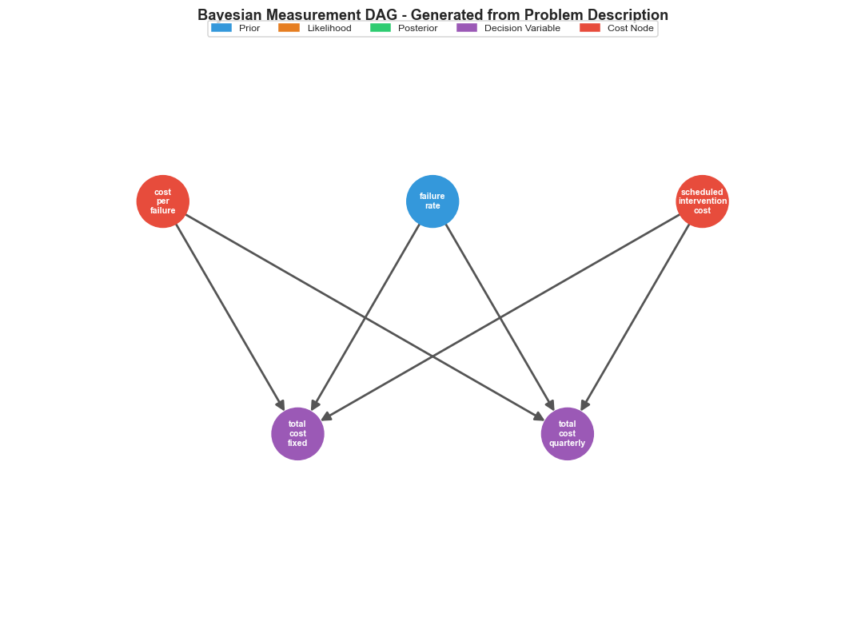
Section 8: Step 4C - Chained Bayesian DAG Visualization
Objective - Visualize the complete Bayesian measurement chain.
Process
Parse measurement nodes from validated JSON
Build directed acyclic graph (DAG) showing dependencies
Color-code nodes by role:
Prior (blue): Initial beliefs
Likelihood (orange): Observed evidence
Posterior (green): Updated beliefs
Decision variable (purple): Quantities for decision making
Cost node (red): Economic consequences
Benefits
Clear visualization of information flow
Identifies critical path dependencies
Validates model structure
Communicates approach to stakeholders
Visual modeling of information flows aligns with Hubbard's emphasis on systematic approaches to measurement in How to Measure Anything (Chapter 7: "The Measurement Process").
RTX Corporation (Corporate) - Company Use This document does not contain any export controlled technical material/data/information.

Slide 17
Section 9: Step 5 - Monte Carlo Simulation & Decision
Objective - Simulate decision outcomes and make evidence-based recommendations.
Process
Sample from posterior distribution of failure rate λ
Propagate uncertainty through cost model:
Expected failures under each strategy
Total cost distributions
Compare strategies using Monte Carlo simulation:
Cost distribution overlap
Probability of each strategy being cheaper
Expected savings
Decision Framework
Recommendation Criteria:
Strategy with lower expected cost
Probability of being cheaper (>50%)
Expected savings magnitude
EVPI consideration for future investments
Output
Quantitative summary of strategy comparison
Visualizations of cost distributions and savings
Clear recommendation with confidence metrics
Future action guidance based on EVPI
Monte Carlo simulation for decision analysis reflects Hubbard's emphasis on probabilistic thinking in How to Measure Anything (Chapter 8: "Decision Making").
RTX Corporation (Corporate) - Company Use This document does not contain any export controlled technical material/data/information.

Slide 18
RTX Corporation (Corporate) - Company Use This document does not contain any export controlled technical material/data/information.

Slide 19
RTX Corporation (Corporate) - Company Use This document does not contain any export controlled technical material/data/information.

Slide 20

BIO
Kirtis Christensen, BSEET, MDIV, LTC Kirtis Christensen is a Life Cycle Engineering Tool Strategist for Raytheon working in SETC. Experience spans Controls, Software Dev, SW QA, Risk Management, and Reliability Engineering (1994 to Present). Completing Doctorate in Strategic Leadership. Chaplain, IN Army National Guard 2004 to present.
E-mail: Kirtis.a.Christensen@rtx.com
RTX Corporation (Corporate) - Company Use This document does not contain any export controlled technical material/data/information.

Slide 21
Thank you.
RTX Corporation (Corporate) - Company Use This document does not contain any export controlled technical material/data/information.

Slide 22
RTX Corporation (Corporate) - Company Use This document does not contain any export controlled technical material/data/information.

